Slide 1

IRI Architecture Team
Architecture 1.0 Summary Guidelines
Release 3
05/2003
Copyright © Information Resources, Inc. 2003. Confidential and proprietary.

Slide 2

Agenda
Copyright © Information Resources, Inc. 2003. Confidential and proprietary.

Slide 3
Agenda
> Agenda
Introduction
(New Horizons) Principles
Initial Fundamental Guidelines
Summary
Appendix A – New Horizons Sample Slides
Appendix B – Compass View Based Tracking Concept
Copyright © Information Resources, Inc. 2003. Confidential and proprietary.

Slide 4
Introduction
Copyright © Information Resources, Inc. 2003. Confidential and proprietary.

Slide 5
Introduction
> Introduction
Growth and change are facts of life. In the face of continued growth and change we can either:
  Proactively attempt to manage growth and change to our advantage through forward planning
  Have growth and change control us by reacting to it in unplanned ways when it occurs
Architecture is an attempt to manage growth and change to our advantage through forward planning.
Copyright © Information Resources, Inc. 2003. Confidential and proprietary.

Slide 6
(New Horizons) Principles
Copyright © Information Resources, Inc. 2003. Confidential and proprietary.

Slide 7
Principles
> (New Horizon) Principles
Principle ID
Principle
Definition
1
Performance
Performance of the new architecture should exceed current system performance in IRI’s legacy environment. From one specific design view, performance can be put in the context of heavy duty OLAP functionality within thresholds acceptable to IRI.
2
Cost
IRI is seeking a value-based solution that meets the current state needs. The investment in this solution should be prioritized and established over time to maximize ROI.
3
Standardization
Adopt industry standards where possible and take advantage of the packages/ tools in order to mitigate risk.
4
Simplification
The future state systems must be consolidated and easier to operate than the existing systems. Providing common infrastructure, managing less variance in the technical environment and developing an architecture that focuses on reuse is key.
5
Scalability
A system design and infrastructure that supports growth. Specifically, from a platform perspective this may include horizontal and vertical scaling at a minimum.
6
Flexibility
The future state architecture must be established such that the business and growth models are enabled moving forward. Technology components must be designed with open integration standards and compatibility throughout.
Copyright © Information Resources, Inc. 2003. Confidential and proprietary.

Slide 8
Principles
> (New Horizon) Principles
Principle ID
Principle
Definition
7
Manageability
Any system that is implemented must be relatively simple and cost effective to maintain and manage. Good examples of this are automating processes and managing job scheduling. From a maintenance perspective, minimal client-side deployment is preferred.
8
Availability
Systems must be operational and available to customers according to business requirements. Specifically, some components of the future state architecture may require varying degrees of availability and the solutions providing accessibility enable those objectives.
9
Reliability
The future state system must operate as expected under load. This includes performance and availability characteristics as well as understanding the behavior of the system, calculating the probability of failure and ensuring completion of transactions in the event of system failure.
10
Functionality
Systems must meet identified functional requirements. Commercial products and customized solution modules must align with these requirements, which may be of a technical or business nature. For the package vs. custom decision, to date, this has generally been referred to as the “80/20” rule of thumb.
11
Modularity
The entire architecture should identify independent subcomponents that have established links with other subcomponents (if needed) to meet specific requirements (business/technical).
12
Security
Future state architectures will consist of secure layers that will manage vulnerability and prevent accidental or unlawful access of the system.
Copyright © Information Resources, Inc. 2003. Confidential and proprietary.

Slide 9
Initial Fundamental Architecture Guidelines
Copyright © Information Resources, Inc. 2003. Confidential and proprietary.

Slide 10
Guidelines – 1. Data Models
> Initial Fundamental Architecture Guidelines
Our primary raw material is data. Therefore a significant emphasis will be placed on ensuring that any data we manage or work with is well modeled.
We have two primary data modeling strategies:
  Highly Normalized models for flexibly supporting On Line Transaction Processing
  Star Schema data models for supporting Analysis and Reporting
Copyright © Information Resources, Inc. 2003. Confidential and proprietary.

Slide 11
Guidelines – 2. Commercial Software Use
> Initial Fundamental Architecture Guidelines
Commercial software should be utilize as widely as possible and reasonable so we can:
  Minimize the amount of generic functionality code we have to develop and manage
  Maximize the amount of time spent developing IRI specific business value added functionality.
  Leverage the billions of dollars spent yearly developing and maintaining commercial code vs. the $10 – $20 million IRI can afford to spend doing the same.
Copyright © Information Resources, Inc. 2003. Confidential and proprietary.

Slide 12
Guidelines – 2. Commercial Software Use
> Initial Fundamental Architecture Guidelines
Note:
  Starting with a $2 million development budget and assuming a 10% increase annually and a 15% support cost to maintain already developed code, in 18 years development cost becomes $10 million and support cost becomes $12 million.
  If we then start to reduce the new development budget by $1 million a year to keep a software development and maintenance budget of about $20 million, by year 28 the new development budget would be virtually $0 and the support budget would be about $20 million.
  Because of this we need to constantly try to identify ways in which we can off load the cost of generic software functionality development to commercial software development institutions so we can focus our limited resources on the development and maintenance of true IRI specific value added code.
Copyright © Information Resources, Inc. 2003. Confidential and proprietary.

Slide 13
Guidelines – 2. Commercial Software Use
> Initial Fundamental Architecture Guidelines
Failure to act proactively in light of the above scenarios will result in one of the following outcomes.
  Our inability to fund new products
  An increase in quality issues due to our inability to adequately support the code base with budgeted personnel levels
Copyright © Information Resources, Inc. 2003. Confidential and proprietary.

Slide 14
Guidelines – 3. Software Architecture
> Initial Fundamental Architecture Guidelines
Enterprise Software Development Model. All new software must enable tight control and a centralized library of re-usable components. This will facilitate a more collaborative, factory based approach to component based software engineering.
Standard Interfaces. Software will support (or have a roadmap to support) standard interface definitions and languages, such as ANSI SQL, widely accepted XML schemas, CWM2 (Common Warehouse Metamodel) and Web Services.
Flexible, Scalable Run-time Model. All new software that will be used in our factory, whether it is commercial or internally developed, should follow and/or facilitate a distributed component/service based model that maximizes artifact reuse and distributed parallel processing.
Copyright © Information Resources, Inc. 2003. Confidential and proprietary.

Slide 15
Guidelines – 4. Data Management
> Initial Fundamental Architecture Guidelines
Use Commercial Software: Commercial software (Relational Databases and Analytic Repositories) should be used as far as possible when we have to store and manage data.
Store Data Once: To help reduce complexity in our environment we want to:
  Minimize the number of places we store the same set of data
  Minimize the storing of data that can be derived from other data in our environment
Create Cohesive Area Views: to facilitate the viewing of all data for a particular area through one interface. For example all Venue data should be viewable through one interface (similar for Item and Consumer).
Copyright © Information Resources, Inc. 2003. Confidential and proprietary.

Slide 16
Guidelines – 5. Transformation Logic
> Initial Fundamental Architecture Guidelines
Manage in a Neutral Repository: A significant part of IRI’s intellectual capital is in transformation logic (measures, projections, base-lining). For various reasons IRI may need to implement a given set of transformation logic in more than one place. To facilitate the proper management of our transformation logic, particularly when it can be utilized in more than one place, an ultimate objective will be to be able to specify all transformation logic in a neutral transformation specification repository.
It is understood that this is particularly challenging concept to implement so it will be approached a little more tentatively then other guidelines.
Copyright © Information Resources, Inc. 2003. Confidential and proprietary.

Slide 17
Guidelines – 6. Security
> Initial Fundamental Architecture Guidelines
Protecting Our Data Assets:
  At the core of our architecture, we must ensure that there is adequate protection around our data and proprietary business rules so every individual or system is able to access only what they are explicitly authorized to access.
Copyright © Information Resources, Inc. 2003. Confidential and proprietary.

Slide 18
Guidelines – 7. Hardware
> Initial Fundamental Architecture Guidelines
Processing: We will move towards utilizing adequately sized and uniformly imaged UNIX and NT multi-processor systems that allow us to maintain a controllable number of machines in the data center and the load balancing of any application across any group of machines with available capacity.
Storage: We will move towards utilizing large scale storage management technology like EMC Symmetrix
Networking: We will need to ensure that the networking infrastructure has the necessary amount of redundancy and bandwidth to be able to handle the needed data flow between systems.
Copyright © Information Resources, Inc. 2003. Confidential and proprietary.

Slide 19
Guidelines – 8. Development Processes
> Initial Fundamental Architecture Guidelines
At any given time we will need to develop and/or enhance IRI specific software.
To do this most efficiently, we need to establish certain development processes and procedures. The following best practices are applicable.
  Develop Iteratively
  Manage Requirements
  Use Component Architectures (facilitate reuse)
  Model Visually
  Continuously Verify Quality
  Manage Change
Copyright © Information Resources, Inc. 2003. Confidential and proprietary.

Slide 20
IRI’s Core Domains
Copyright © Information Resources, Inc. 2003. Confidential and proprietary.

Slide 21
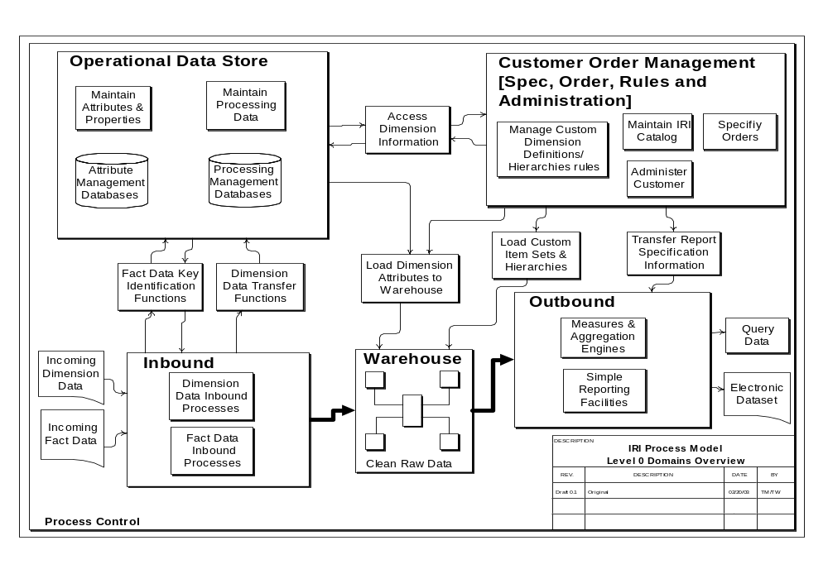
Identified IRI Core Domains
> IRI’s Core Domains
Copyright © Information Resources, Inc. 2003. Confidential and proprietary.

Slide 22
Summary
Copyright © Information Resources, Inc. 2003. Confidential and proprietary.

Slide 23
Summary
> Summary
Principles
  Performance
  Cost
  Standardization
  Simplification
  Scalability
  Flexibility
  Manageability
  Availability
  Reliability
  Functionality
  Modularity
  Security
Guidelines
  Data Models
  Commercial Software Use
  Software Architecture
  Data Management
  Transformation Logic
  Security
  Hardware
  Development Process
Core Domains
  Inbound
  Operational Data Stores
  Customer Order Management
  Data Warehouse
  Outbound
Copyright © Information Resources, Inc. 2003. Confidential and proprietary.

Slide 24
Project Omega & Current Architecture
Copyright © Information Resources, Inc. 2003. Confidential and proprietary.

Slide 25
Project Omega & Current New Architecture
Project Omega Vs. Current New Architecture
Omega
  Primary focus was shifting our data processing from mainframe to Unix.
  Some core systems related to our POS data processing were upgraded.
  The Architecturally significant item was the move from mainframe to Unix.
  The development utilized 3 GL coding methodologies so no significant development and maintenance cost savings could be realized.
Copyright © Information Resources, Inc. 2002. Confidential and proprietary.

Slide 26
Project Omega & Current New Architecture
Project Omega & Current New Architecture
Current New Architecture
  Accepts that a large project is too expensive: A large project to move everything to the new architecture has been ruled out as too costly for IRI at this time.
  Therefore the main focus is to:
    Implement tools and methodologies that will minimize the amount of code that IRI will need to write and maintain when developing new functionality.
    Define standards for new deliverables that are not possible or extremely difficult to create under the current architecture.
  Complement and gradually replace: The idea is to initially complement rather than replace the current environment when new functionality is needed and to do so in a way that facilitates the gradual replacement of the current environment over time as dictated by business need. A continuous improvement process.
Copyright © Information Resources, Inc. 2002. Confidential and proprietary.

Slide 27
Project Omega & Current New Architecture
Project Omega & Current New Architecture
Current New Architecture
  In a nutshell, the objective of the new architecture is to define standard tools, platforms, processes and methodologies for the orderly development new systems at IRI.
  These objectives are being achieved primarily through
    Advanced data modeling concepts
    The strategic application of commercial tools
    “Agile” application development processes.
  The new Architecture concepts can be profitably applied to any project where significant new development is required or where the old architecture cannot provide the needed functionality.
  It requires no significant hardware platform shifts.
Copyright © Information Resources, Inc. 2002. Confidential and proprietary.

Slide 28
Project Omega & Current New Architecture
Project Omega & Current New Architecture
Summary Comparisons
Omega
Primary focus:
  Hardware Platform Change.
Current New Architecture
Primary Focus
  Advanced data modeling concepts – using the appropriate model type in the appropriate place.
  Commercial tools implementations
  “Agile” application development processes.
  Complement and gradually replace
  No significant hardware platform changes required.
  Large project to move to new Architecture ruled out due to cost.
Copyright © Information Resources, Inc. 2002. Confidential and proprietary.

Slide 29
Applying the Guidelines – Architecture Decisions 2003
Copyright © Information Resources, Inc. 2003. Confidential and proprietary.

Slide 30
Background
Architecture Decisions 2003
Constraint. IRI Must make changes the old fashioned way – “bootstrapped.” New Horizon project cancelled.
Change. Technology and Culture are equally important
Initial Adoption. Significant shifts should be tested with POCs, then at 6-12 month preliminary adoption.
Checkpoints. Significant shifts should require a second selection or a significant milestone review.
Dependencies. Many technology decisions have “coupling” to other decisions. However, they should be made under their own merit, with a scorecard item indicating integration importance.
Copyright © Information Resources, Inc. 2002. Confidential and proprietary.

Slide 31
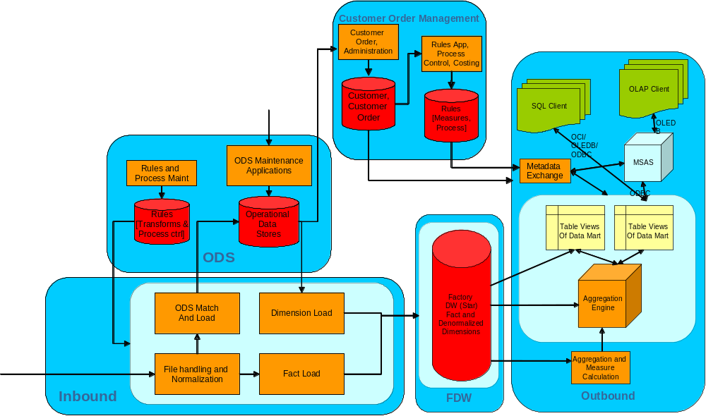
Architectural Context – System Wide Change
Architecture Decisions 2003
Pervasive. Architecture recommends new software throughout most all of the IRI systems.
Managed Sequence. Changes should be managed in a planned manner to maximize adoption and business impact.
Partnership. Architecture, AD and PMO should work as equal partners to own adoption and success of technologies.
Copyright © Information Resources, Inc. 2002. Confidential and proprietary.

Slide 32
Architectural View - In
Architecture Decisions 2003
Subsystems
Data Loading (ETL)
Rules App and Repository
Data Profiling
Matching and Cleansing
Venue ODS Maintenance App Dev Platform
Item ODS Maintenance App Dev Platform
Consumer ODS Maintenance App Dev Platform
Customer
Order,
Administration
ODS
ODS Maintenance
Applications
Rules and
Process Maint
Rules
[Transforms &
Process ctrl]
Operational
Data
Stores
FDW
Factory
DW (Star)
Fact and
Denormalized
Dimensions
Inbound
ODS Match
And Load
Dimension Load
File handling and
Normalization
Fact Load
Copyright © Information Resources, Inc. 2002. Confidential and proprietary.

Slide 33
Architectural View - Out
Architecture Decisions 2003
Customer Order Management
Customer
Order,
Administration
Outbound
Rules App,
Process
Control, Costing
OLAP Client
SQL Client
Customer,
Customer
Order
Rules
[Measures,
Process]
OLEDB
OCI/ OLEDB/ODBC
MSAS
Metadata
Exchange
Subsystems
FDW Platform*
Main Aggregation Engine*
Customer Order Mgmt and Admin
Presentation Cube*
Rules Application and Repository
Front end Reporting, BI & Data MiningTool(s)
ODBC
FDW
Table Views
Of Data Mart
Table Views
Of Data Mart
Factory
DW (Star)
Fact and
Denormalized
Dimensions
Aggregation
Engine
Aggregation and
Measure
Calculation
*These platforms support various interface or data access methods. Standards should be set to maintain common interfaces.
Copyright © Information Resources, Inc. 2002. Confidential and proprietary.

Slide 34
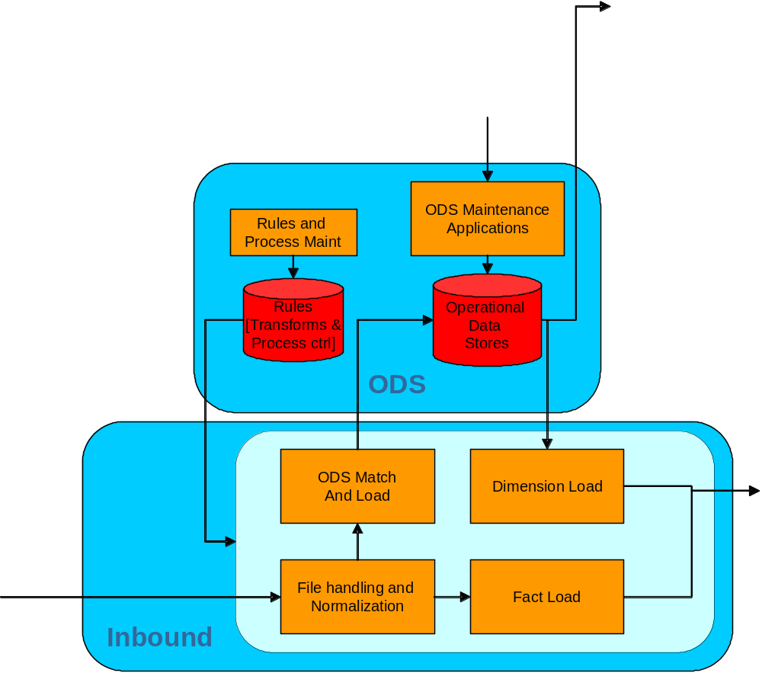
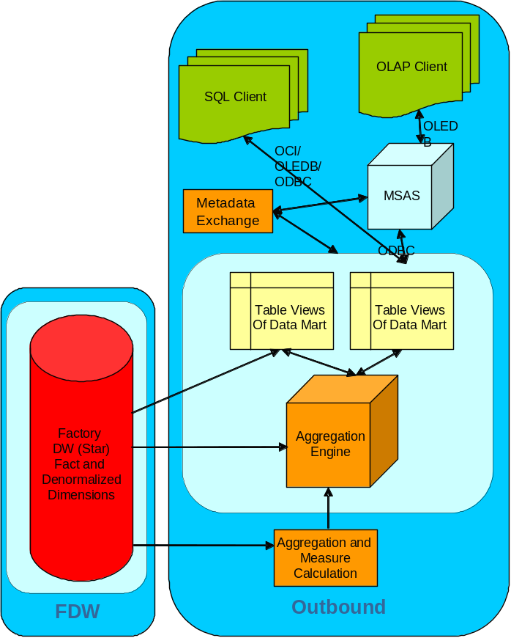
Architectural View - Global
Architecture Decisions 2003
Subsystems
Data Integration Platform
Security
Data Models
Software Architecture and Libraries
Customer Order Management
Customer
Order,
Administration
Rules App,
Process
Control, Costing
Customer,
Customer
Order
Rules
[Measures,
Process]
Copyright © Information Resources, Inc. 2002. Confidential and proprietary.

Slide 35
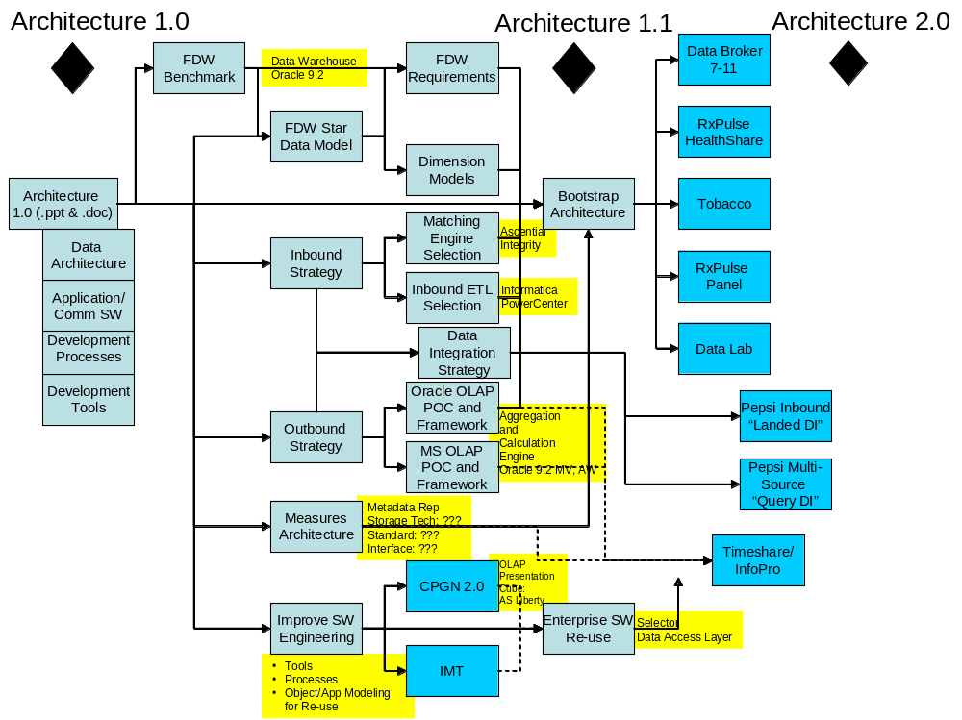
Architectural Decisions and Major Framework Components – Timing
Architecture Decisions 2003
2002 was largely R&D and high-level design
2003 is split R&D, with applied design guidelines and initial Commercial Software adoption
2004 will realize re-use and more substantial cost, flexibility gains against new products and services
2002 | 2003 | 2004
Copyright © Information Resources, Inc. 2002. Confidential and proprietary.

Slide 36
Key 2003 Architecture Decisions Summary
Architecture Decisions 2003
Key Architecture Concept | Decision Needed | Status and Comments
Appropriate data model implementation | Implementation approval | Approved, being implemented by project
Matching Tool acquisition | Purchase approval | Approved, purchased & implemented
ETL Tool acquisition | Purchase approval | Approved – Next steps purchase & implement
Initial FDW implementation | Initial implementation Platform | Oracle assumed, explicit sign off needed
Final FDW implementation | None immediately | Need to complete POC’s & analysis for decision grid
Venue Database Upgrade/Consolidation | None immediately | Need to create a phased development plan
BI Landscape | None immediately | Need to complete POC’s & analysis for decision grid
Copyright © Information Resources, Inc. 2002. Confidential and proprietary.

Slide 37
Appendix A – New Horizons Sample Slides
Copyright © Information Resources, Inc. 2003. Confidential and proprietary.

Slide 38
Notes
> Appendix A - New Horizons Sample Slides
The following slides were taken “as is” from New Horizons presentations that highlighted how and why IRI needs to develop Architecturally.
Copyright © Information Resources, Inc. 2003. Confidential and proprietary.

Slide 39
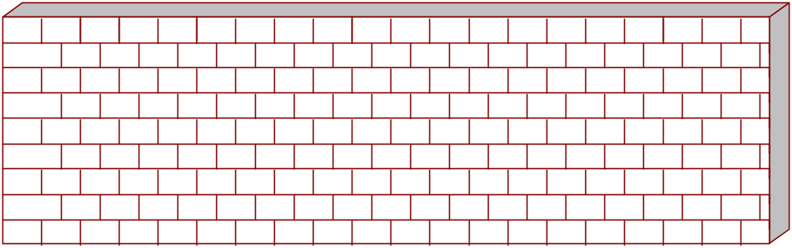
> Appendix A - New Horizons Sample Slides
New Horizon Situation
IRI’s legacy technology is a barrier to growth & savings
  Complex, inflexible framework
  Proprietary, closed systems
  Uncompetitive speed of innovation
  Unnecessarily costly & manual
Competitive Disadvantages
(Nite / InfoPro)
New Products Slow to Market
(Convenience Stores)
Client Satisfaction
Issues
(Data Consistency)
Vulnerable to Market Changes
(Wal-Mart)
Restricts Partnering
Copyright © Information Resources, Inc. 2003. Confidential and proprietary.

Slide 40
> Appendix A - New Horizons Sample Slides
New Horizon Strategic Direction
IRI Today
Static Historical
Market Benchmarking Data
For CPG Manufacturers
IRI Tomorrow
Dynamic, Predictive
Data-Based Actions & Transformation Services Company
For the CPG Industry
Copyright © Information Resources, Inc. 2003. Confidential and proprietary.

Slide 41
> Appendix A - New Horizons Sample Slides
New Architecture - Competitive Differentiation
The next generation of Information Services will open new avenues for growth
Moving from custom data to range of services...
Range of Data Transformation Services
NEW HORIZON
TODAY
Flexible Foundation Components
IRI Supplied Services
User-Driven Personalized
DATA
TOOLS
REPORTS
ANALYTICS
Faster
Early measure alerts
Flexible Formats
Multiple hierarchies
UPC and non-UPC
Integrated across types, locations
New Measures of Retailer & Consumer
Web-delivered, ready-to-use insights at desktop
Rigid Formats
12-19 days after close
UPC Code
Set Hierarchies
Web OSA
InfoPro (Microsoft)
Panel access included
Compatible with alternative tools
“Lite/Medium options
Incompatible
Limited use
(OSA for Analysts)
“Pulse” Key Performance Indicators
Intelligent Alerts
Reporting Presentation
Robust Personalization
Client Self-authoring services support
Templates
TCS builds custom
Provided by AIG personnel in hard copy format
Static Studies
Internet Delivery
Turnkey production
Data cube feeds into client models, data warehouses
Dynamic studies with scenario, testing tools online
Client Self-serve guided analysis with imbedded models online
Copyright © Information Resources, Inc. 2003. Confidential and proprietary.

Slide 42
> Appendix A - New Horizons Sample Slides
Competitive Landscape
IRI ACN
Flexibility
Access
Speed
Accuracy
Reliability
X
X
X
X
X
X
We need to compete on Speed, Accuracy, and Reliability
Copyright © Information Resources, Inc. 2003. Confidential and proprietary.

Slide 43
Appendix B – Compass View Based Tracking Concept
Copyright © Information Resources, Inc. 2003. Confidential and proprietary.

Slide 44
Notes
Appendix B – Compass View Based Tracking Concept
The following slides were taken “as is” from presentations for a follow on project called Compass that also highlighted how and why IRI needs to develop Architecturally.
Copyright © Information Resources, Inc. 2003. Confidential and proprietary.

Slide 45
Tracking Data
What we’ve heard from the industry
> Appendix B – Compass View Based Tracking Concept
“Want flexibility”
  Look at business through the consumers’ and retailers’ eyes
  Data that is tailored to the specific business issue
  Deal cost effectively with unanticipated needs
“Want comprehensive, inside IRI walls integrated data”
  Combinations of store, panel & audit data
  Cross-category, cross-country
“Want faster and more frequent access to data”
“Want more value from On-Sites/Analysts”
  Knowledge workers and heavy users waste time pulling and manipulating data to meet end-user needs
Copyright © Information Resources, Inc. 2003. Confidential and proprietary.

Slide 46
View-Based Tracking Data
How Will It Work?
> Appendix B – Compass View Based Tracking Concept
Comprehensive Information Assets
Broader than Category (department?)
Single source access regardless of data type: POS, panel, audit, etc
More geo.’s: Media, Consumer, etc.
Data Views Tailored to Business Issue
Library of product hierarchies, geography definitions, and report/analysis specification available for subscription
  Retailer Views, Functional Views (e.g. Sales, Marketing)
  Consulting services available to create custom views
Data is accessible as it becomes available
Robust Tools for Analysis, Authoring & Publishing
Robust query engine, report/template/database authoring & publishing tools
Consulting services available to author & publish
User-friendly End User Access via Web
Report/template/alert access, simple database query
Issue specific applications
Portal
Copyright © Information Resources, Inc. 2003. Confidential and proprietary.

Slide 47
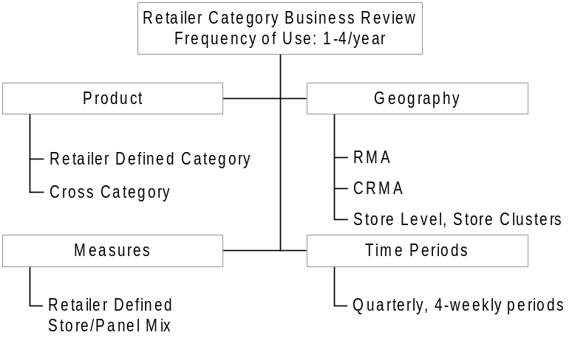
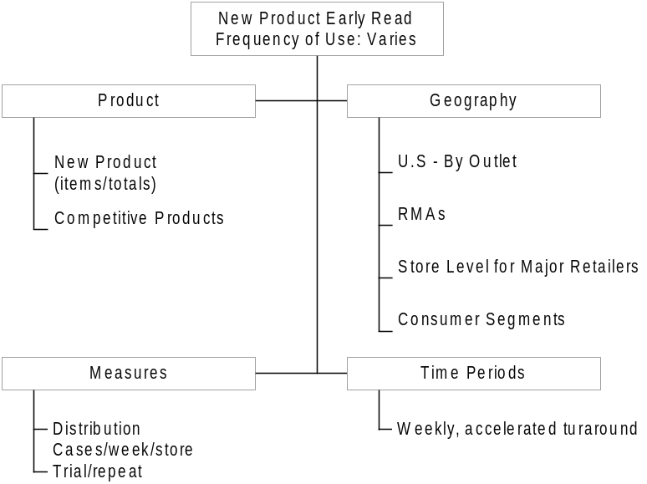
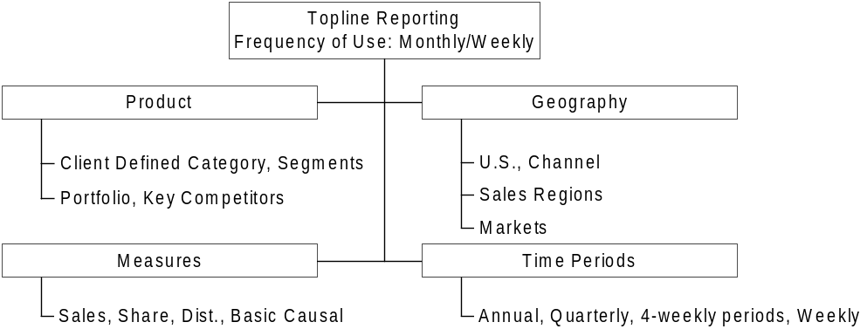
> Appendix B – Compass View Based Tracking Concept
Tracking Data
Today
  Large, complex, resource intensive database(s)
  Best data for the purpose not always easy to get to
  Significant amount of ‘inventory’ goes ‘unused’
Copyright © Information Resources, Inc. 2003. Confidential and proprietary.

Slide 48
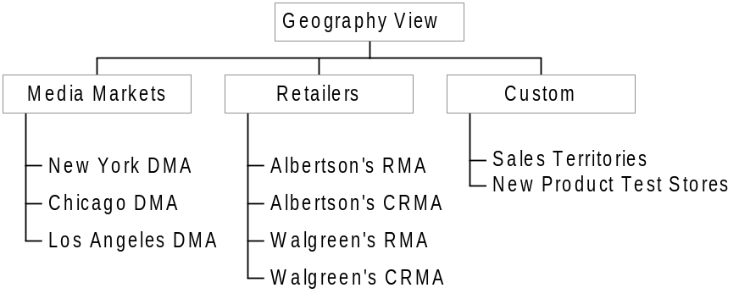
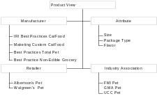
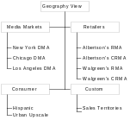
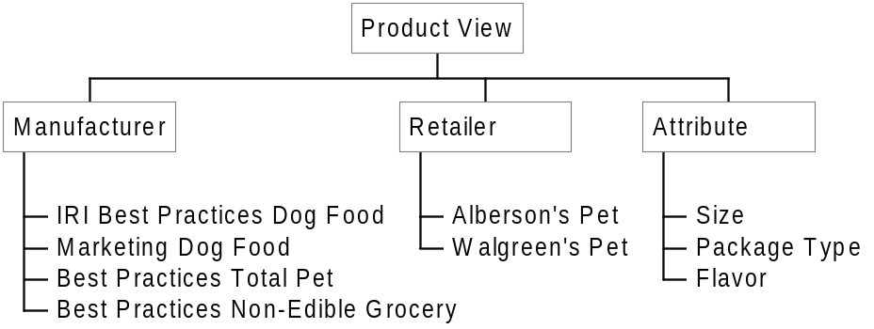


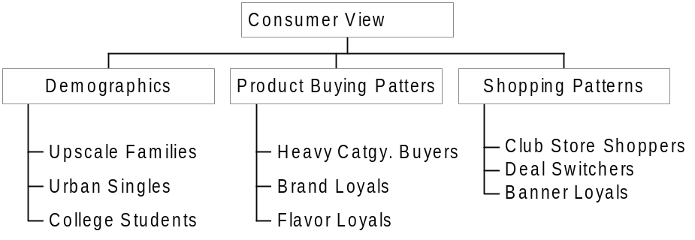
Views-Based Tracking
Hierarchy Library, Flexible Options to Meet Range of User Needs
> Appendix B – Compass View Based Tracking Concept
IRI Library of Views
Client “A” Views
Authoring & Publishing Tools
Cubes/Databases
End-user Files (Office, HTML)
Analytic Views
Toplines/ Templates.Etc.
Simple Query & Applications
Reports, KPIs, Toplines, Alerts
PORTAL
Copyright © Information Resources, Inc. 2003. Confidential and proprietary.
Notes:
With a more relational architecture, we would create “Views Based Tracking” where data is delivered as requested on a “just in time” basis and in more flexible views such as media markets or retailer hierarchies.
IRI anticipates it could reduce the cost of POS and Panel tracking and reporting, but even more valuable is that this environment enables greater integration of any data type. This is a foundation for both Phase II and III enabling new sources of data to augment both POS and panel.

Slide 49
View-Based Tracking Data
Benefits
> Appendix B – Compass View Based Tracking Concept
Information Effectiveness
  Wider use of cross-category, panel, store level & audit data - new insights from combinations of data
  Retailer views foster collaboration
  More relevant geographies, product aggregates and time periods yield greater insight
Information Efficiency
  Output tailored to the specific need has more utility
  Resources directed at producing only the most relevant, useful data output
  Timely data is accessible as needed
  Unanticipated needs dealt with cost-effectively
Knowledge Worker Productivity
  Flexible data, up-to-date tools, and service options lower cost to distribute information to end users
Copyright © Information Resources, Inc. 2003. Confidential and proprietary.

